Slide 1
Introduction to Quantum Information Processing
Difference between classical logical bit and quantum qubit
Introduction to Quantum superposition, interference and entanglement

Slide 2
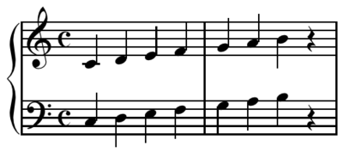




Classical information as binary bits

Slide 3
Processing binary bits
Classical computers are not so different from computing with pen and paper:

Slide 4
Processing binary bits
Classical computers are not so different from computing with pen and paper:

Slide 5
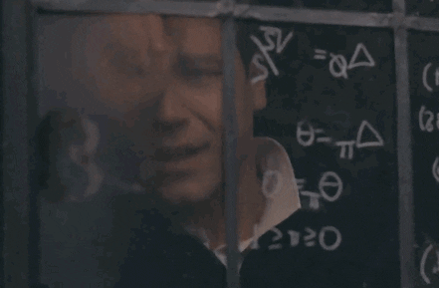
Processing binary bits
Classical computers are not so different from computing with pen and paper (or window glass):

Slide 6
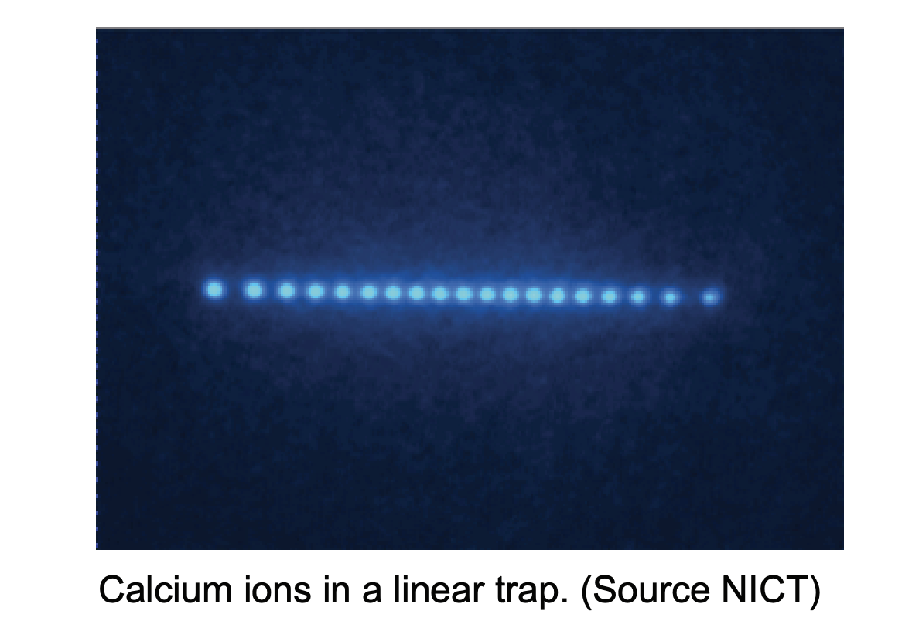
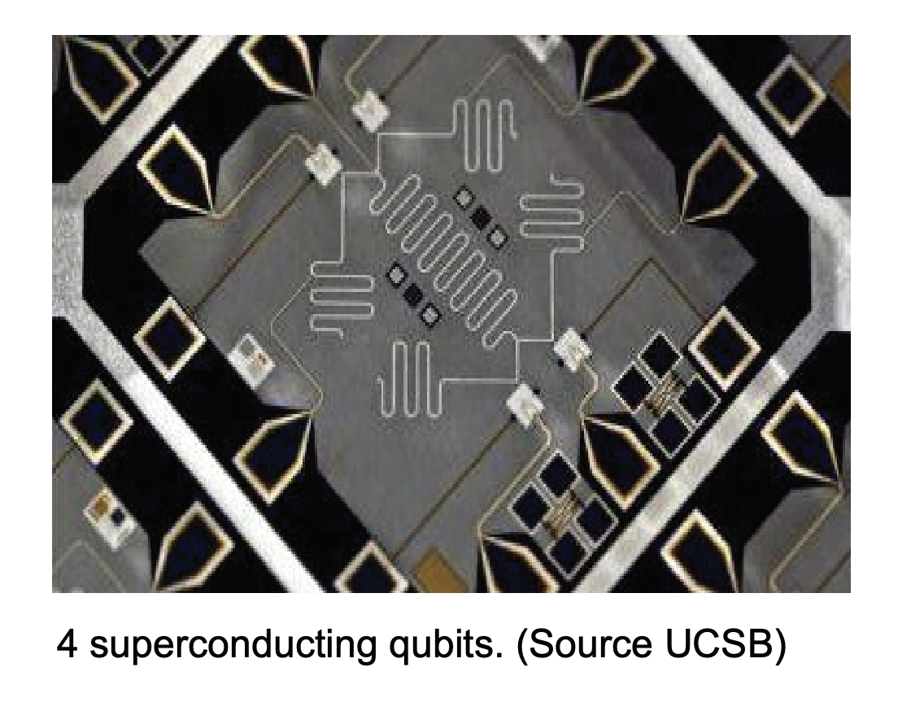
Quantum information processing
The philosophy: Thinking of nature itself as computation
Quantum computers uses precise control of quantum systems and its computation power is only bounded by the law of physics

Slide 7
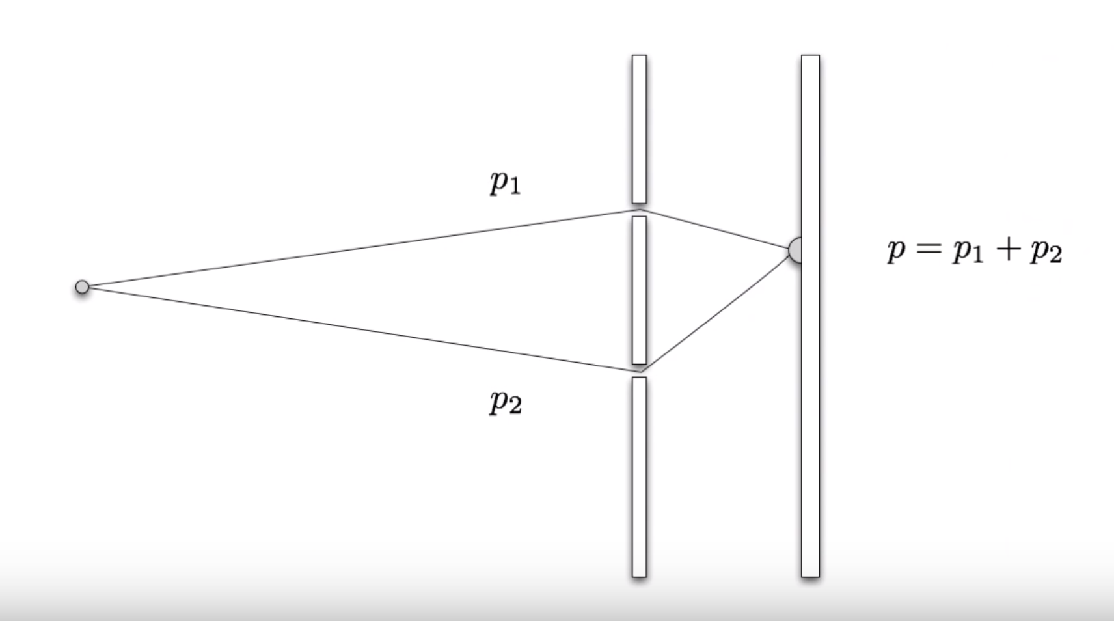
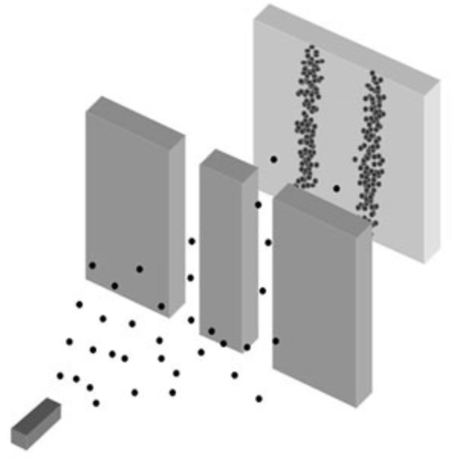
Quantum mechanics: Superposition & Interference
It is all about interference.
Imagine classical billiard balls through double-slits:

Slide 8
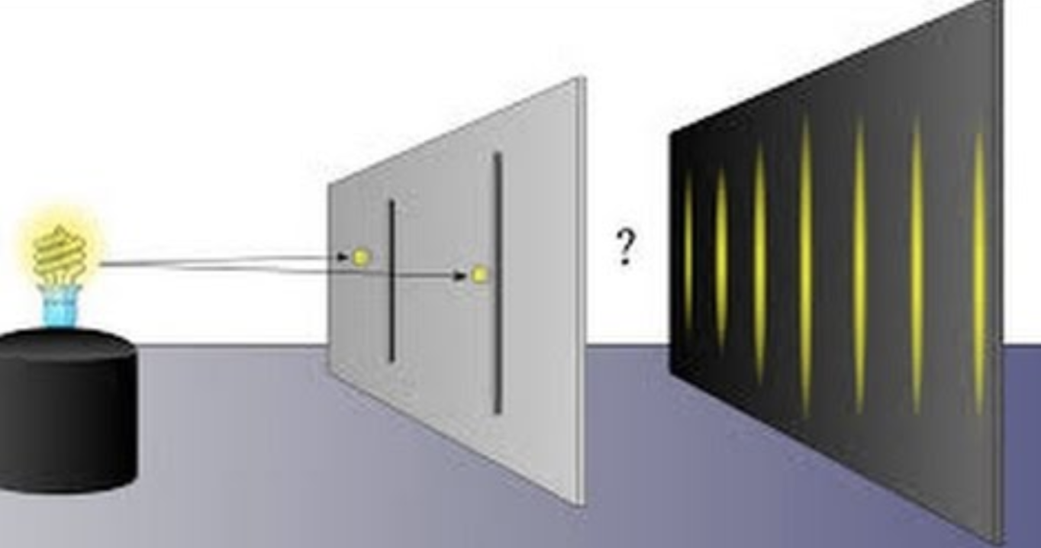
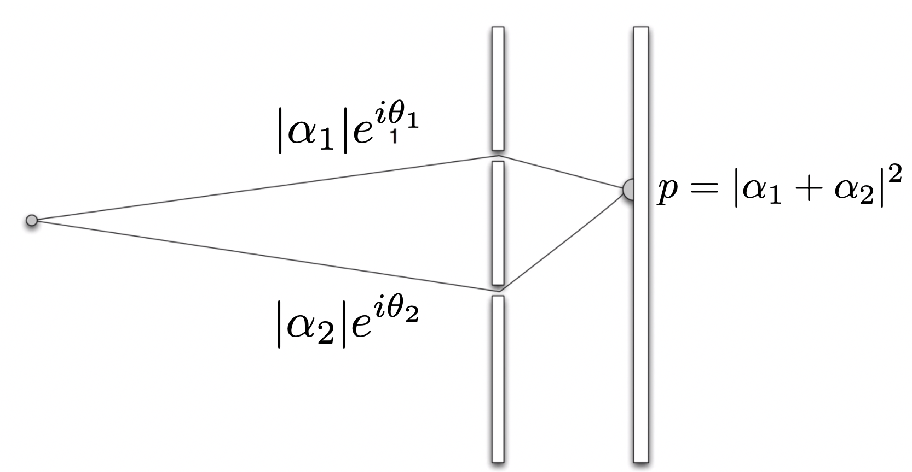
Quantum mechanics: Superposition & Interference
Interference of quantum particles exhibit wave-light behaviour even when fired one-at-a-time:
Quantum correction term on probability distribution that gives rise to interference

Slide 9
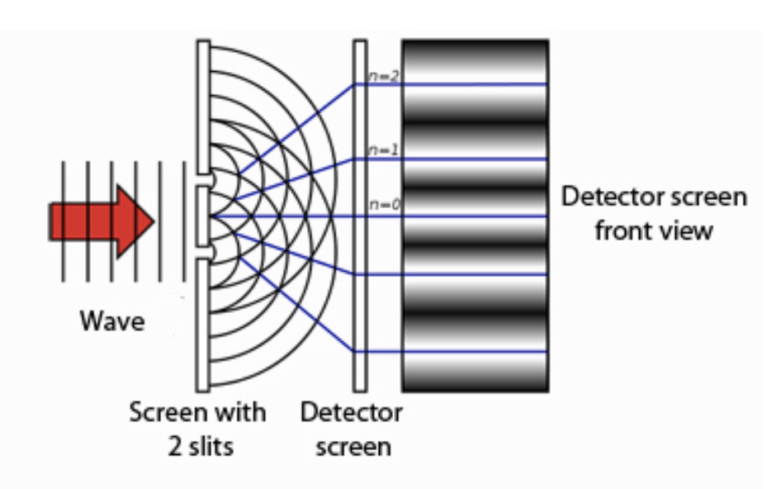
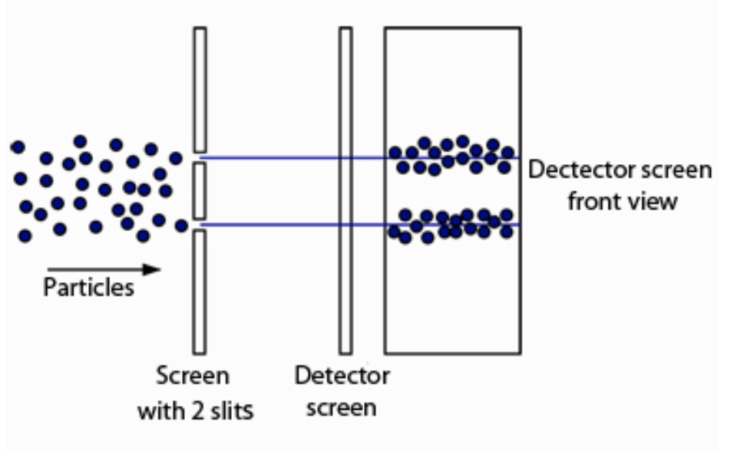
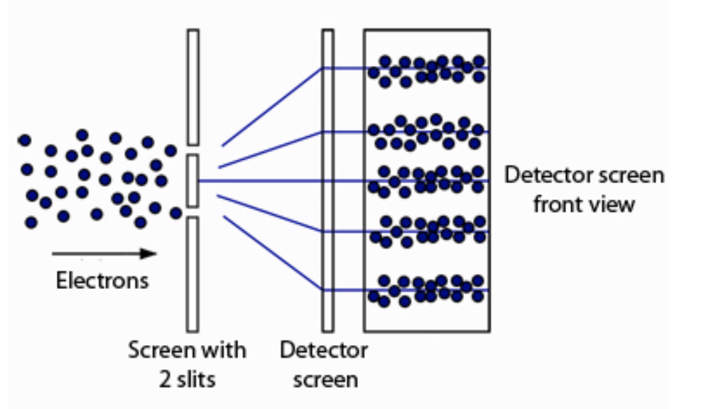
Quantum mechanics: Superposition & Interference

Slide 10
All about interference: a high-level picture for QC
Consider randomised computation (classical scenario):

Slide 11
All about interference: a high-level picture for QC
Consider randomised computation (quantum scenario):

Slide 12
Superpositions in physics

Slide 13
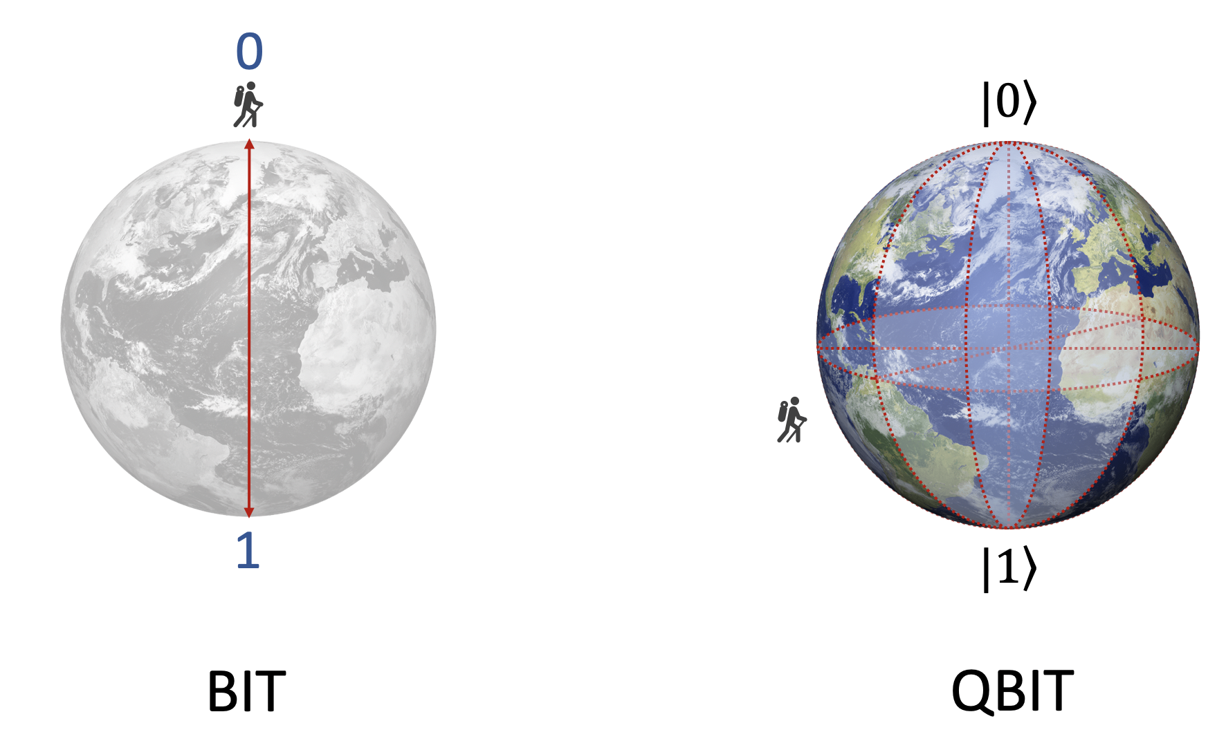
From physics to information: The Qubit
From “1 or 0” to “1 and 0” but weighted by complex numbers:
The amplitudes are NOT directly accessible!

Slide 14
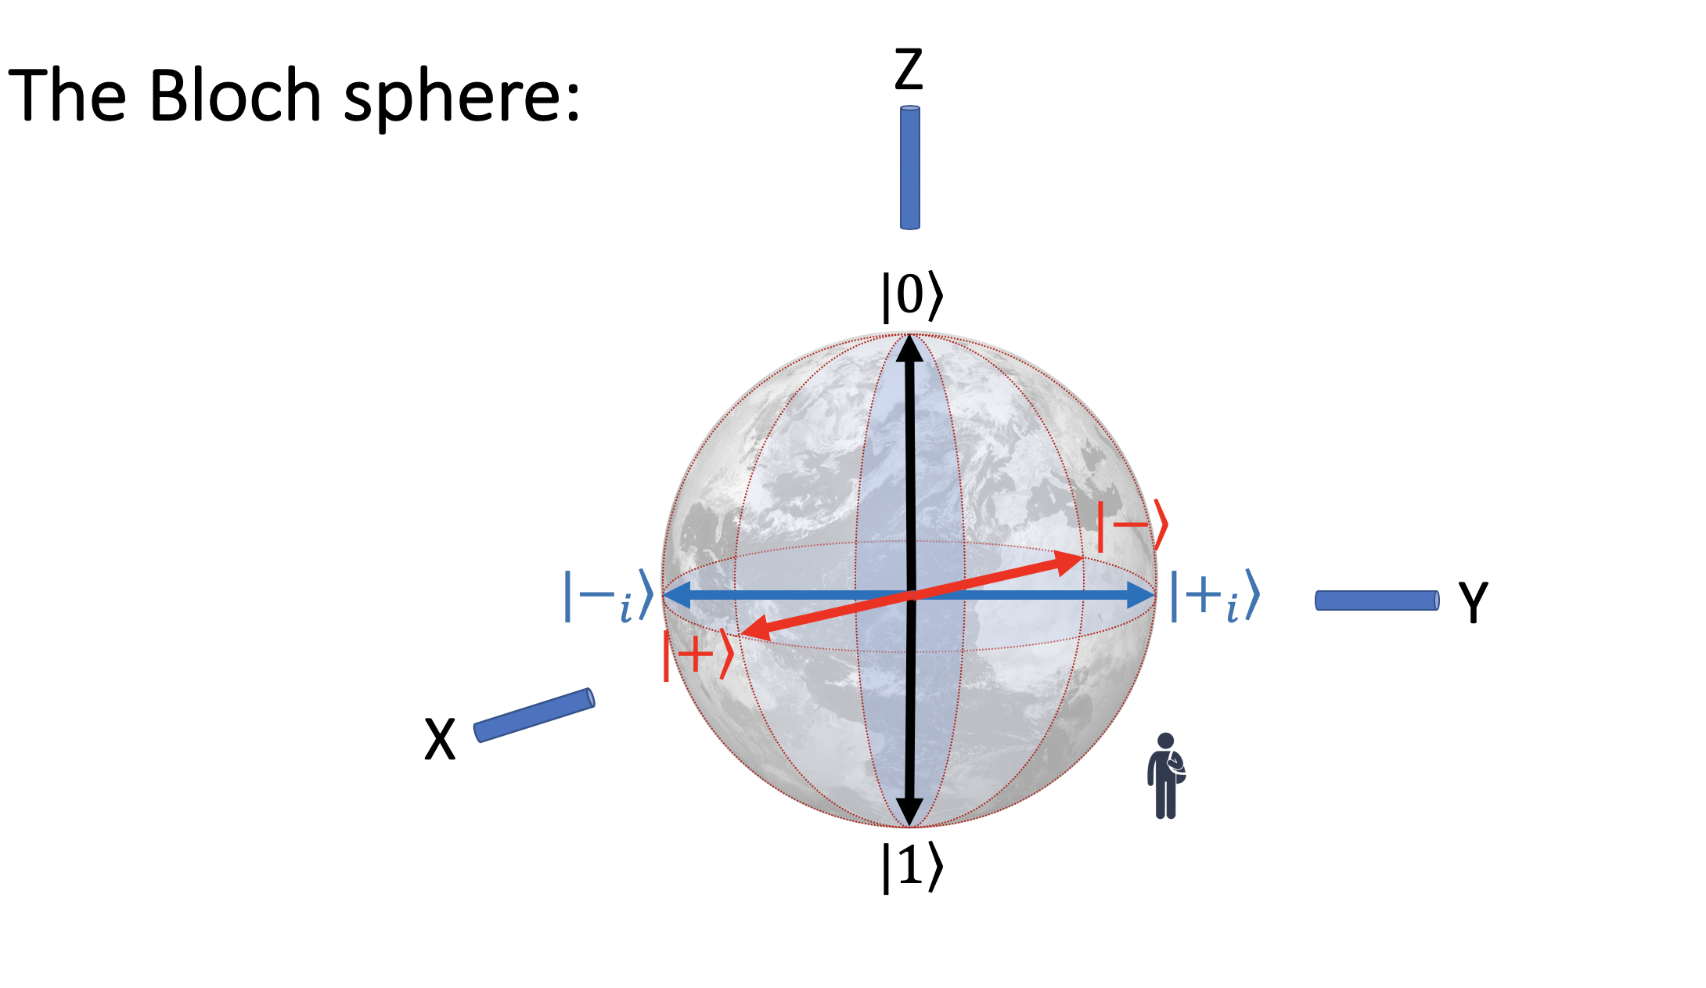
From physics to information: The Qubit
The amplitudes are NOT directly accessible!

Slide 15
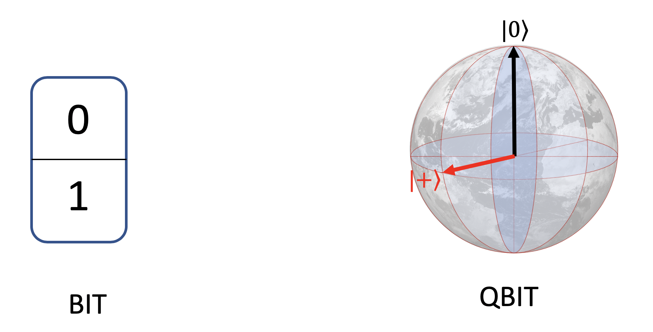
The Qubit

Slide 16


Quantum computing illustrated: 3-qubit example
Number of qubits:
Number of possible configuration of {0,1} :
Each configuration is associated with a complex amplitude.
The list of amplitudes is NOT directly accessible!

Slide 17
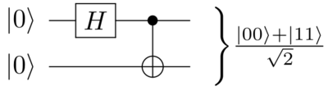
Entanglement
Consider equal mixture of

Slide 18
Exponentially large state space
Encoding information with physical systems
qubits
Complexity explodes exponentially
electrons/atoms/photons etc.
Not directly accessible, hard to simulate with any classical machine
Number of possible configurations and amplitudes
Total # of atoms in the universe:
# of qubits to saturate the whole universe’s computational resources:

Slide 19
Why quantum computing?
Non-classical Logic
What can quantum computers do?

Slide 20
Classical 1-bit logic
Complete set of Classical Logic
Or
Leave both
Flip “0” only
Or
Or
Flip “1” only
Or
Flip both
Or

Slide 21


Quantum computing illustrated: Logic gates
Operations that changes the values of alphas but keep the squared sum to 1.
Non-classical Single qubit gates:
Quantum Logic

Slide 22
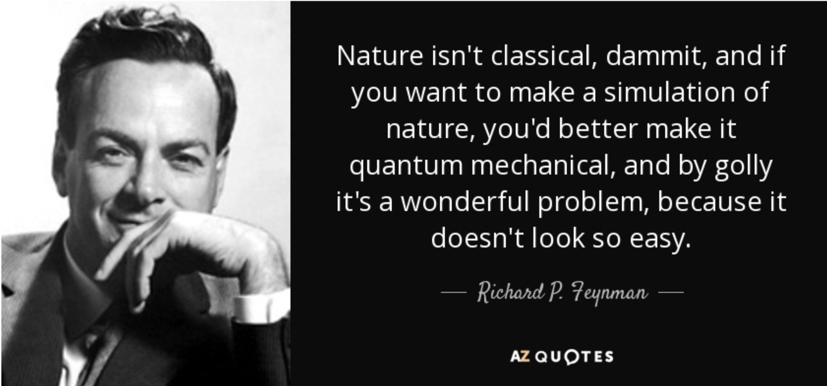
Original motivation : Simulating quantum mechanics

Slide 23

Example: Nitrogen fixation
Making Ammonia fertilizer by binding Nitrogen and Hydrogen
Plants know how to do it efficiently but we don’t.
Current approach of Haber-Bosch process with metal catalyst consumes 1-3% of global energy!
Quantum computing in the future can potentially discover the efficient mechanism and drastically improve the process.
Similar high-stake hard computational problems also feature in lithium battery research and carbon capture technologies

Slide 24
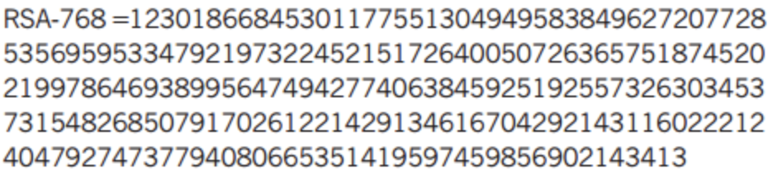
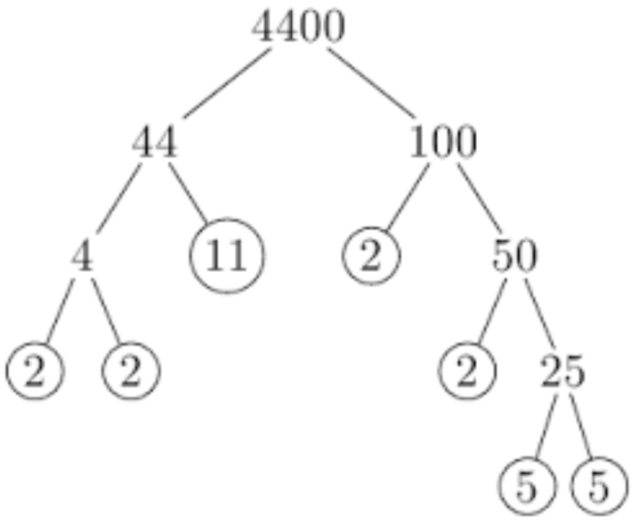
Disruptive application: Code breaking (RSA & Shor)
Security of most today’s online data encryption systems relies on the hardness of factoring
Quantum algorithm using superposition and interference can factor exponentially faster (Shor’s 1994)
?
?

Slide 25
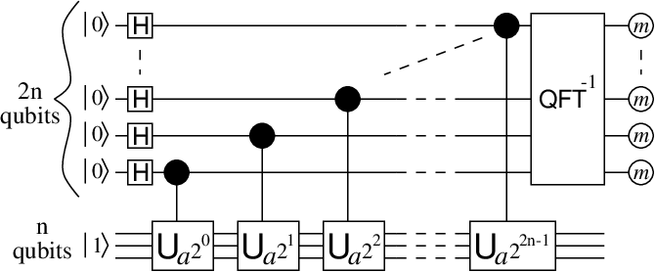
Disruptive application: Code breaking (RSA & Shor)
Security of most today’s online data encryption systems relies on the hardness of factoring
Quantum algorithm using superposition and interference can factor exponentially faster (Shor’s 1994)

Slide 26
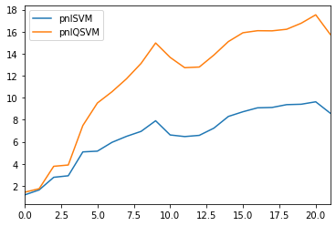
Other Applications
Machine learning
Optimization
Chemistry
Quantitative finance

Slide 27
Current landscape of quantum computing
Contemporary quantum computers and access availability
Quantum advantage and the NISQ era

Slide 28
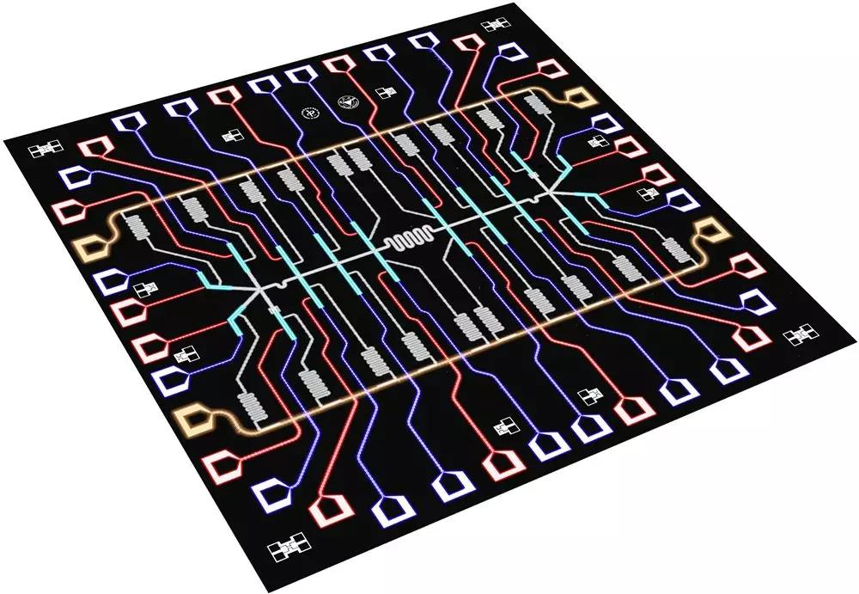
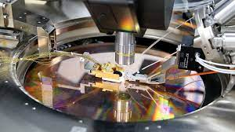
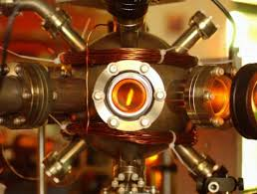
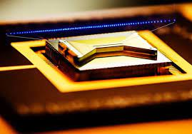
Types of quantum computers

Slide 29






Access and availability
Cloud access

Slide 30
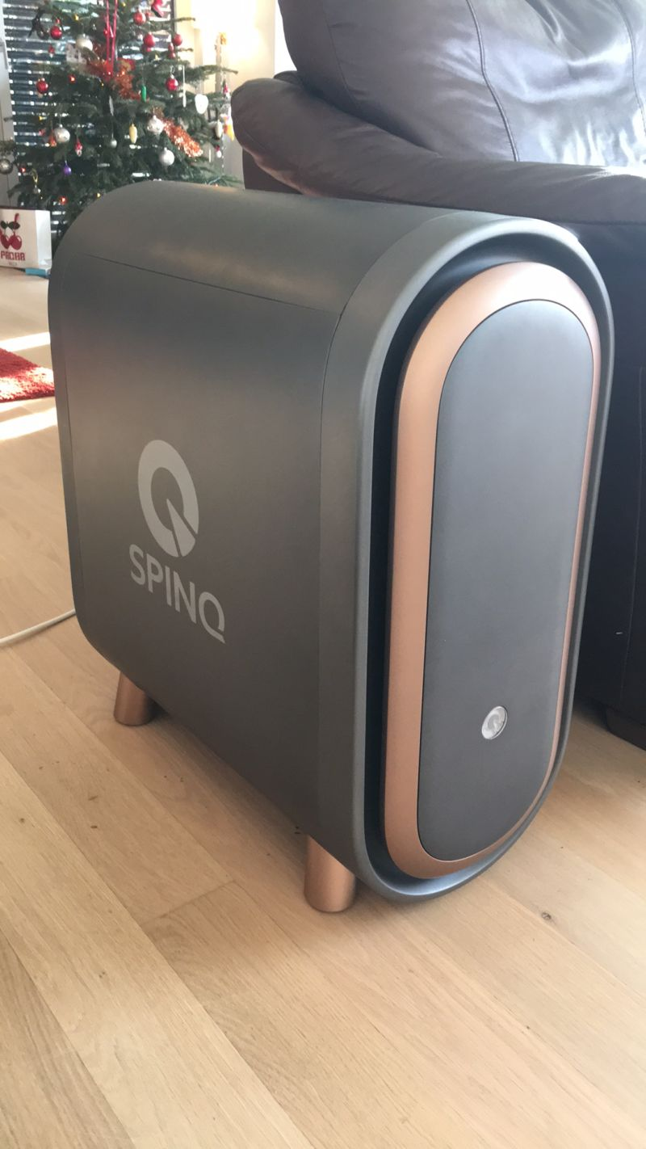
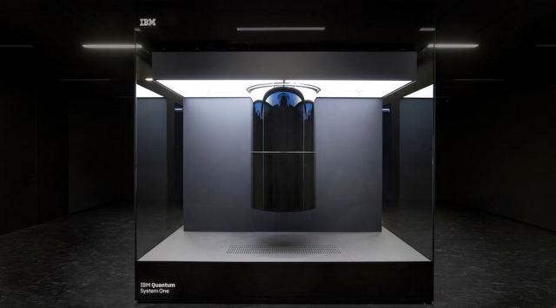
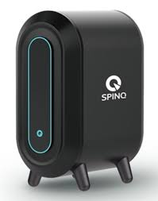
Access and availability
Offline physical hardware: IBM Quantum System One, SpinQ
(Good for demonstration of principle and educational purposes)

Slide 31
Landscape of quantum advantage
Time efficiency & Energy efficiency
“Quantum supremacy”
Current limitation and compromise

Slide 32
Near term: Variational quantum circuits
With shallow-depth circuits with limited number of noisy qubits.

Slide 33
Hybrid Quantum-Classical algorithm

Slide 34
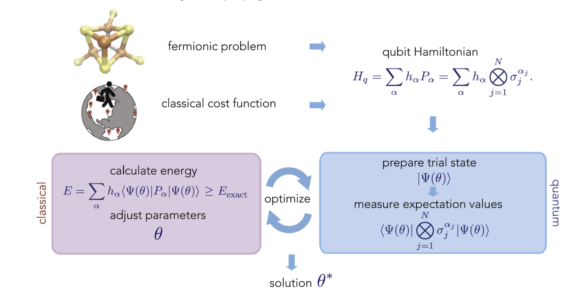
Variational quantum eigensolvers:
Image reference: Nikolaj Moll et al 2018 Quantum Sci. Technol. 3 030503

Slide 35

To be continued…
Conceptual tool box for quantum computing
Essential quantum algorithms
Quantum machine learning models and application (QSVM, QGP, QNN etc. )

